Slide 1

Aircraft Domain Security Enhancement
Demo: Sprint 3
By: Group 6
Anthony Johnson, Matthieu Privat, Charles Gilmore, Jacob Stephens, Allen Biagetti, Jorge Santos, Maxwell Gorley, and Max Wilson
Notes:
Anthony?

Slide 2
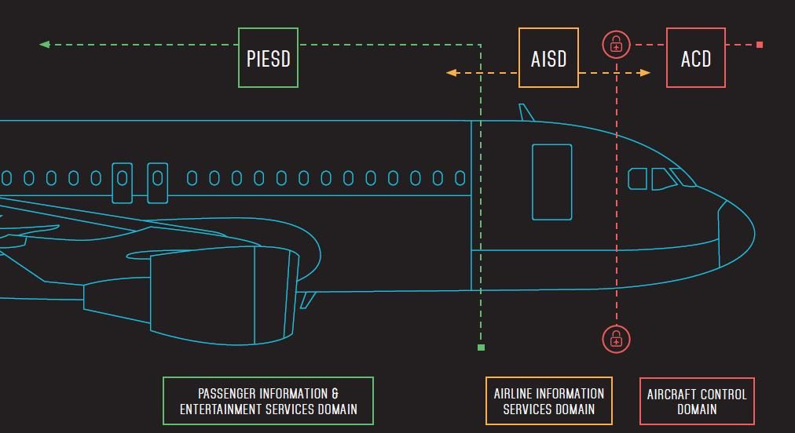
Introduction
How can an aircraft system domain be emulated and tested for cybersecurity?
Notes:
Anthony

Slide 3
QEMU Emulation
QEMU+KVM & Virt Manager
Benefits:
QEMU Emulation supports a broader array of computer architectures
Can emulate hardware & software unlike regular virtual machine softwares
Drawbacks:
Limits development from hardware and access constraints
Difficult to configure networking
Notes:
Max G

Slide 4
Previous Progress
Aircraft Domain Security Enhancement (ADSE)
Designed ADSE System Architecture
Implemented Rudimentary AISD Network
Developed Components for Penetration Testing toolkit
Tested live malware on the host-only network
Notes:
Charles
Recap of sprint 1-3
We are working on the ADSE, consists of: Configuring AISD, Developing pen testing kit, ctp with final product
Previous progress in sprint 1:
Designed ADSE system
Implemented bare bones AISD network
Previous Progress in sprint 2:
Designed and developed components for penetration testing toolkit
Tested malware on our host-only network
ADSE = Aircraft Domain Security Enhancement
AISD = Aircraft Information Services Domain

Slide 5
Project Timeline
Sprint 1:
Designed & set up test nodes for basic files/communication between systems
TFTP Server, Gate Access Point, Printer, etc.
Sprint 2:
Start testing the network for communication and functionality on a more robust scale
Start pentesting toolkit
Researched packet sniffer and MITM code
Researched trojan viruses
Designed Pentest Plan
Sprint 3:
Secure main system
Configured closed off internal network to test malware
Attempt to establish firewall and antivirus software (Didn’t reach)
Assemble Pentesting Toolkit Components
RAT Trojan - technowhorse
MITM - Bettercap
Notes:
Allen B

Slide 6
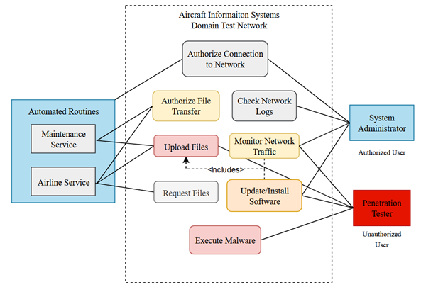
Use Cases of AISD
Notes:
Anthony

Slide 7
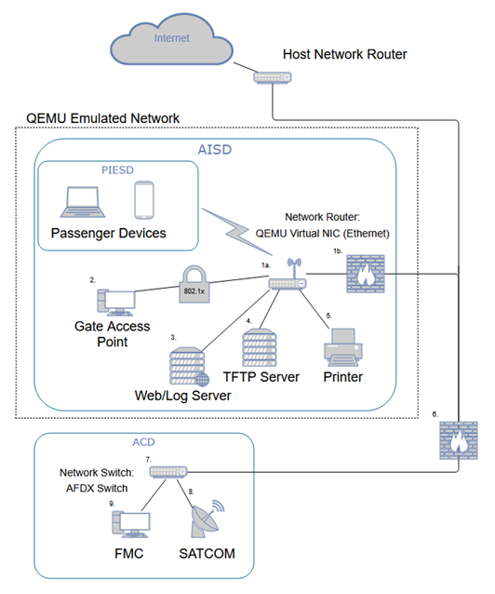
System Architecture & Breakdown
Emulation of Aircraft Network System
QEMU virtualization
Multiple nodes implemented
Software & hardware implementation
Penetration testing toolkit
Components developed in Python
ParrotSec & Kali Linux
Github Repository: mwils1426/CS-490
Notes:
Anthony

Slide 8
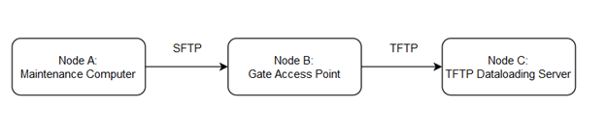
Pentest Plan
Routines:
Define all network nodes involved in a process
Testing occurs between connection of nodes
Testing involves verifying Confidentiality, Integrity, & Availability
Example Routine: Maintenance Update (ZIP file)
Notes:
Anthony

Slide 9


AISD Network Testing
Notes:
Max G

Slide 10
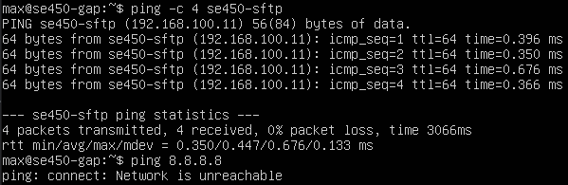
QEMU Emulated Network
Used TAP device to set up isolated network
VMs can talk to each other, but not to other networks or the Internet
Makes penetration testing much safer
Notes:
Max G

Slide 11
MITM Attack
Conducted with Bettercap
ARP/DNS Spoofing
Targeted Packet Sniffing
Terminate Target Connectivity
Scripting (Caplets)
Future Plan
Use BetterCap to intercept, modify, and disrupt routines on the network
Notes:
Jacob

Slide 12
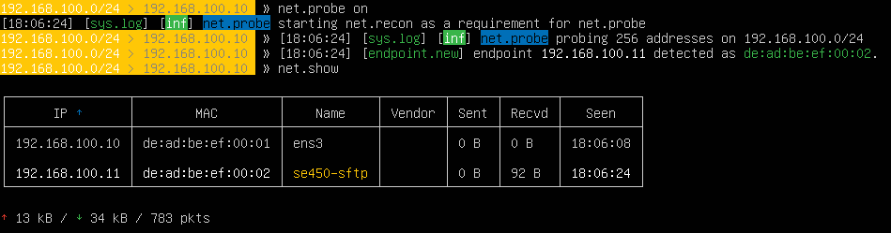
Bettercap on
Emulated Network
Source Code Retrieved from:
https://github.com/bettercap/bettercap
Notes:
Matthieu P.

Slide 13
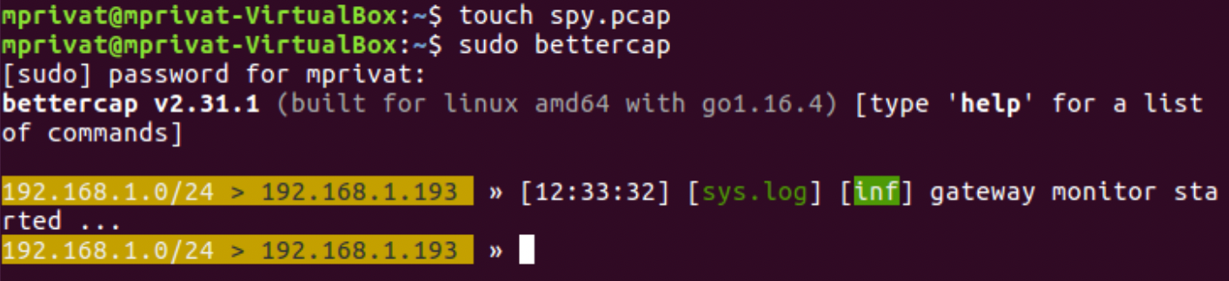
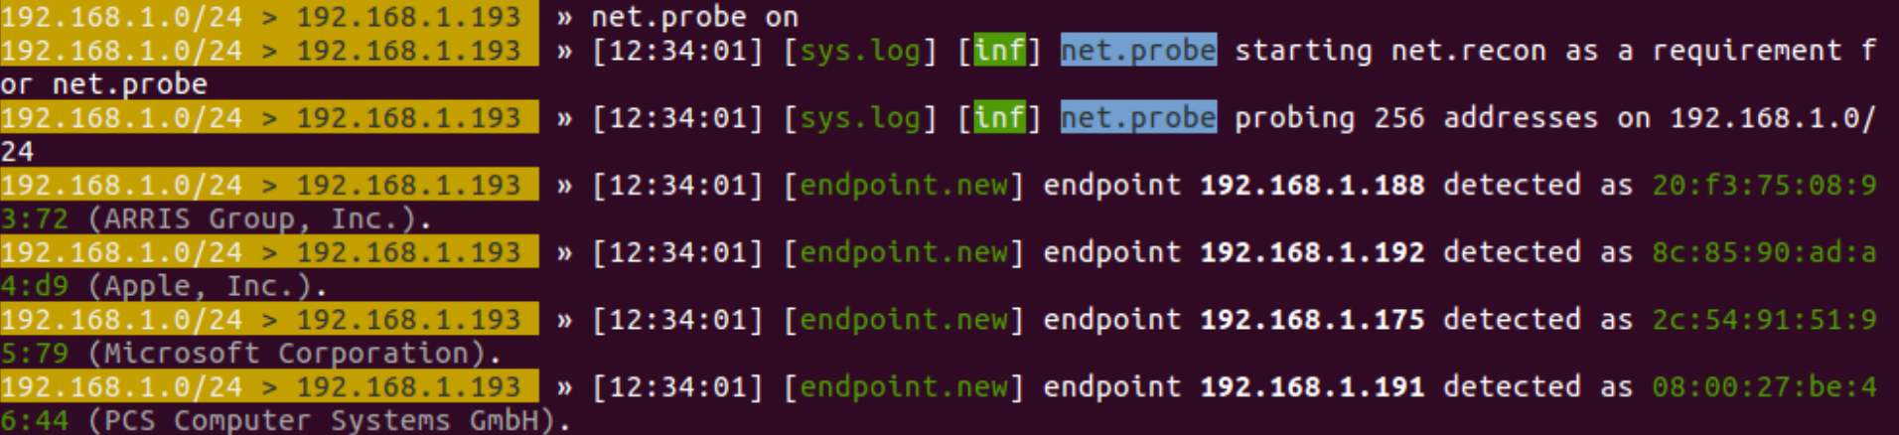
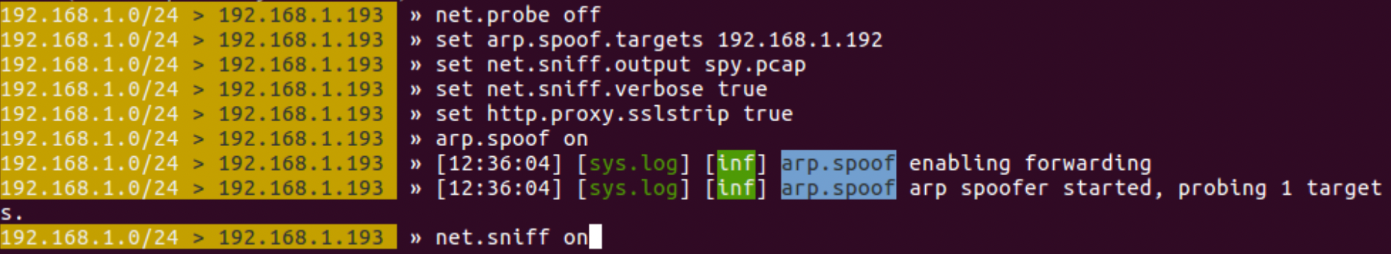
Confidentiality Test
Create a .pcap file to store data
Launch Bettercap from the Attack Machine
Probe for IPs on network
Here we will see all devices on the aircraft’s network
Perform Sniffer’s setup
Begin spying on the targeted IP
Notes:
Matthieu P.

Slide 14

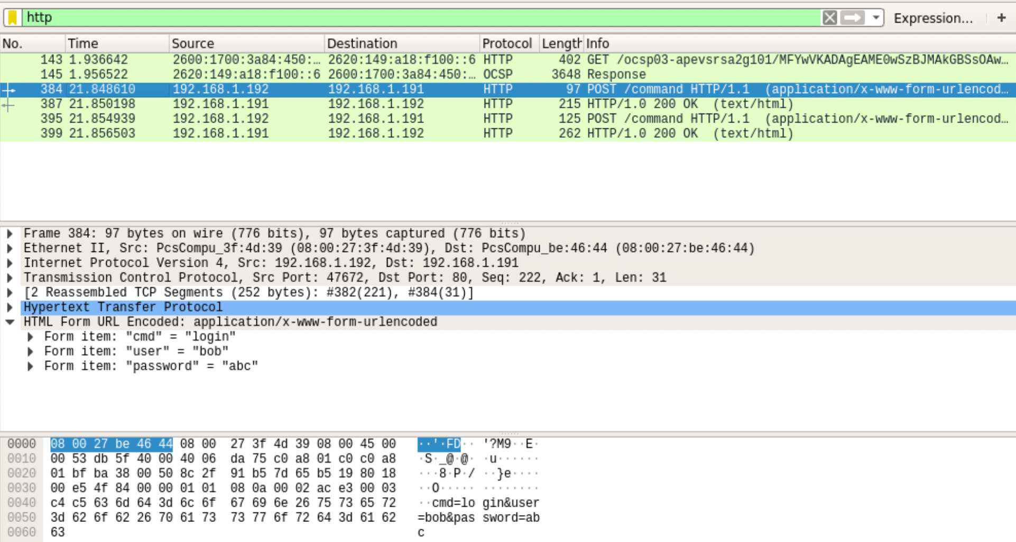
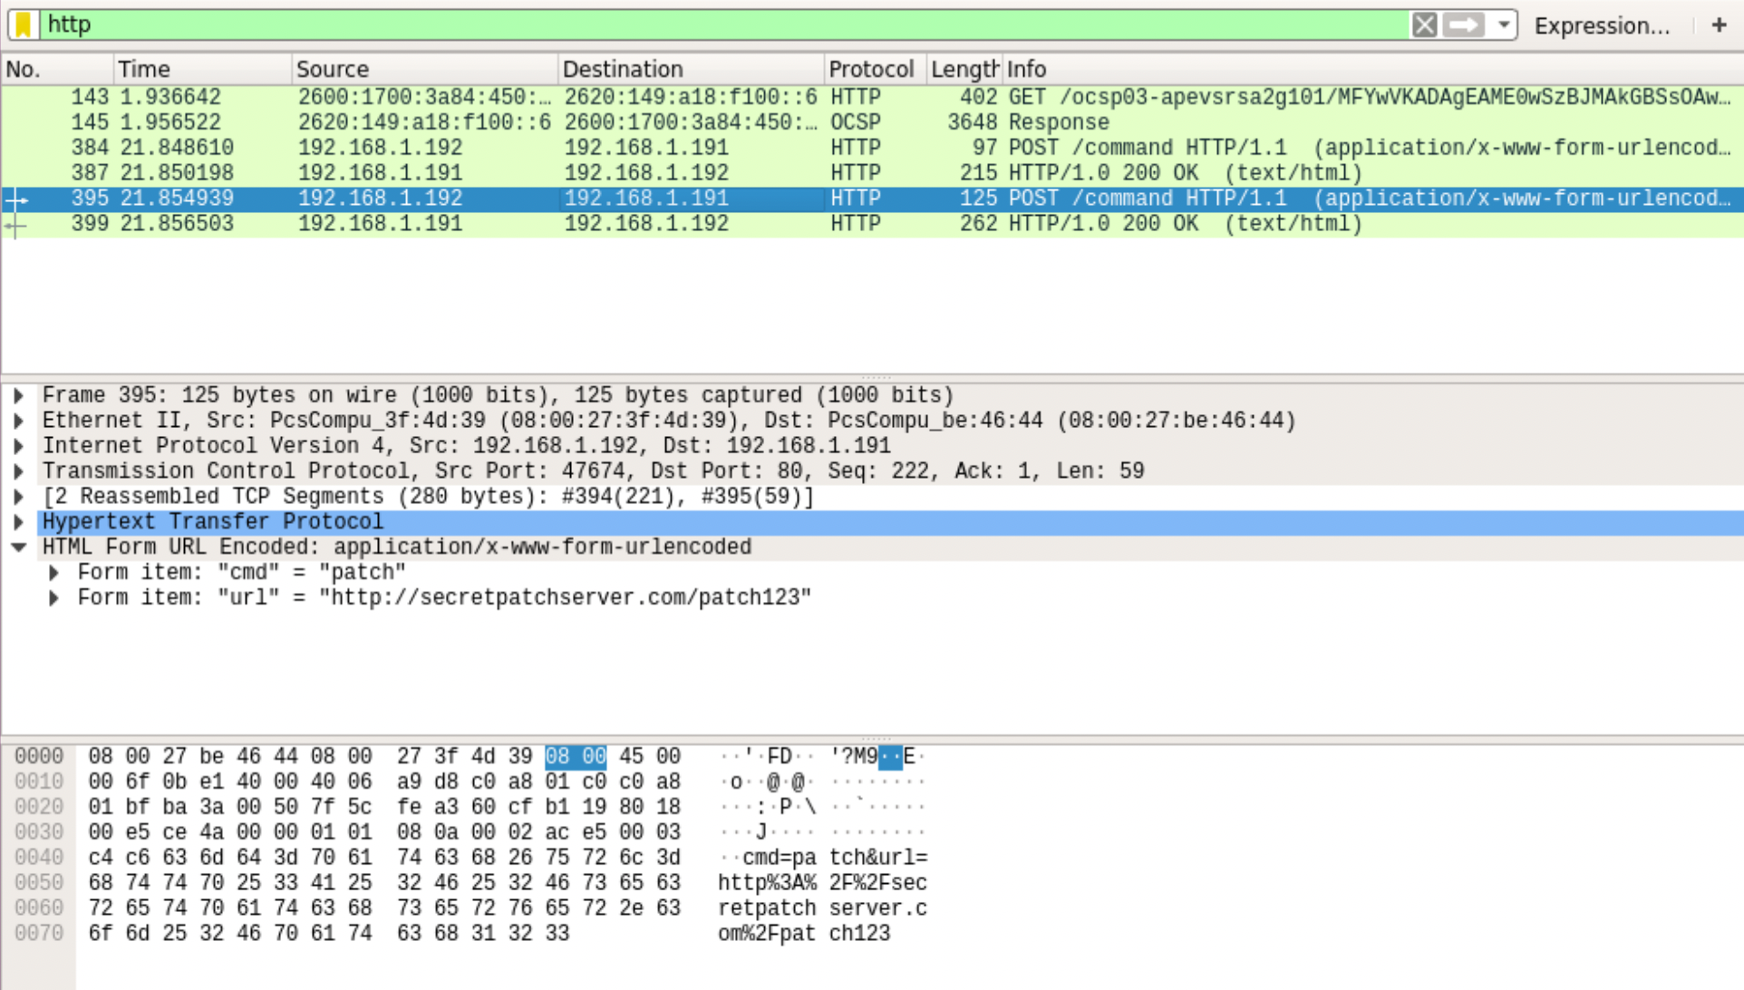
Confidentiality Test Cont.
Notes:
Matthieu P.

Slide 15
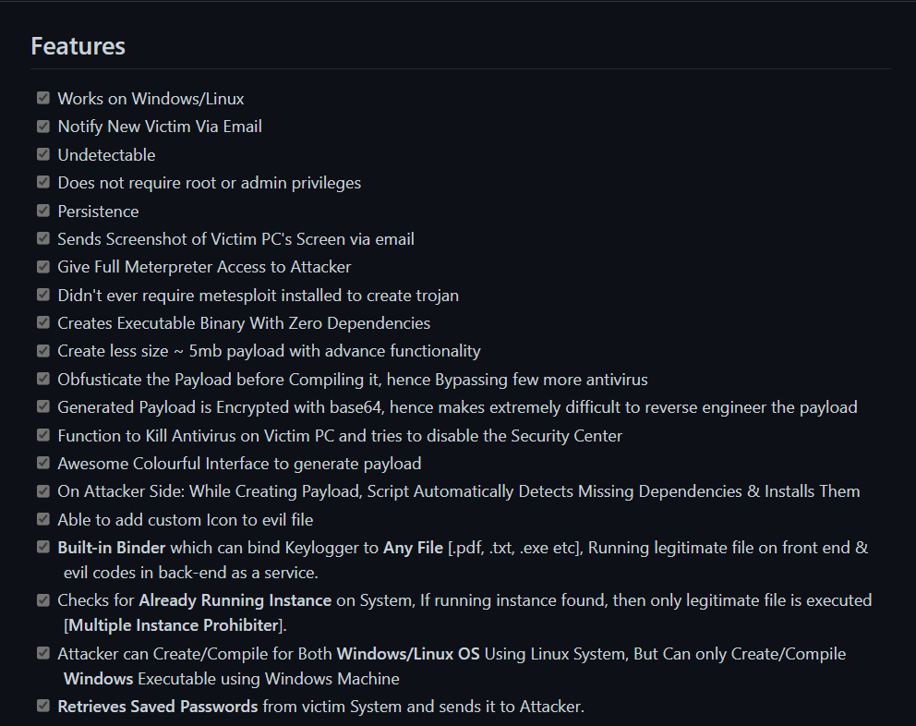
“Technowhorse” RAT Trojan
Goal: To pass through the Gate Access Point firewall and antimalware software to get into the host-only network. Once inside, check to see if the anti-virus software has been neutralized, then have the program send an email back to the user confirming the system was compromised.
Source Code Retrieved from: https://github.com/PushpenderIndia/technowhorse
Notes:
Max W
Notes: So another main goal we had this sprint, and towards the end of this semester was to test the capabilities of the network and get a baseline for what malware can affect it before securing it.
Wanted to test this during this sprint but did not get to it
Found off of github, very versatile and uses Python -> infiltrate network and can kill antivirus software
Then it sends an email back to the user confirming a compromise, which can be seen on the next slide

Slide 16
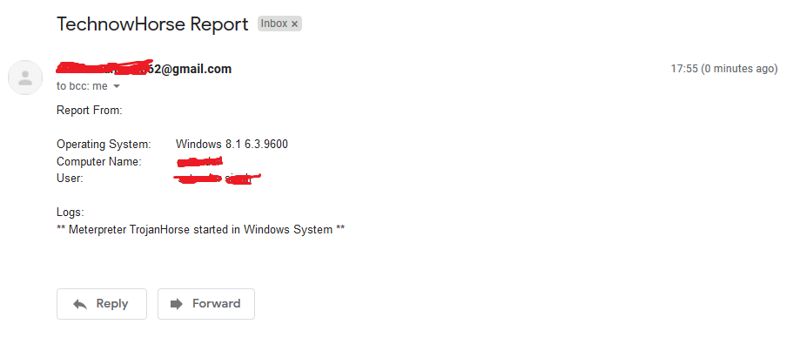
Testing of the RAT
Notes:
Max W
Along with receiving this confirmation, the user can then receive emails about passwords from the target computer and even gain access to critical file systems such as the MBR and make itself persistent in the system.

Slide 17
Future Plans
Revising the emulated AISD network to pass first order security tests
Seeking out more threats the exploit
Investigating NIST standards to add more rigor to testing documents
Using funding to order hardware for final tests
Notes:
Max W
Overall we have set up a baseline of the network this smeester which will be combined into one system along with hardware next semester.
We created a penetration testing toolkit which can be expounded upon at a later point and already has a variety of tools within it such as the MITM and trojan that can be modified for any purpose
Plan to look into even more threats next semester once the system has been hardened and secured more
Look into stronger forms of standards for testing to better document work done so far
Use the funding received to buy a computer that will run as a main server for all parts of the aircraft domain network, as well as possibly by aircraft computer components to further test the capabilities of the system (network switch)

Slide 18
Questions?
Anthony Johnson - Software Engineering: johna143@my.erau.edu
Max Wilson - Computer Science: wilsot45@my.erau.edu
Matthieu Privat - Computer Science: privatm@my.erau.edu
Maxwell Gorley - Software Engineering: gorleym1@my.erau.edu
Jacob Stephens - Computer Science: stephj32@my.erau.edu
Allen Biagetti - Electrical Engineering: biagetta@my.erau.edu
Charles Gilmore - Computer Engineering: gilmorc5@my.erau.edu
Jorge Santos - Computer Engineering: santoj18@my.erau.edu
Notes:
Max W.
And that is all…Any Questions?

